Slide 1
Project WALL-E
Gulnoza Khakimova
Ly,Sang Minh
Murali Krishna Sai Chukka

Slide 2
Introduction
Wall-E is a remote and self control car.
We control the car using mobile app.
Auto Pilot feature will detect obstacles and will
avoid them.

Slide 3
Parts and Sensors
Ultrasonic Sensor.
Arduino Mega 2560.
Motor driver shield (L289D).
Servo.
Bluetooth HC-05.
9V Battery.
4 wheels and motors.

Slide 4
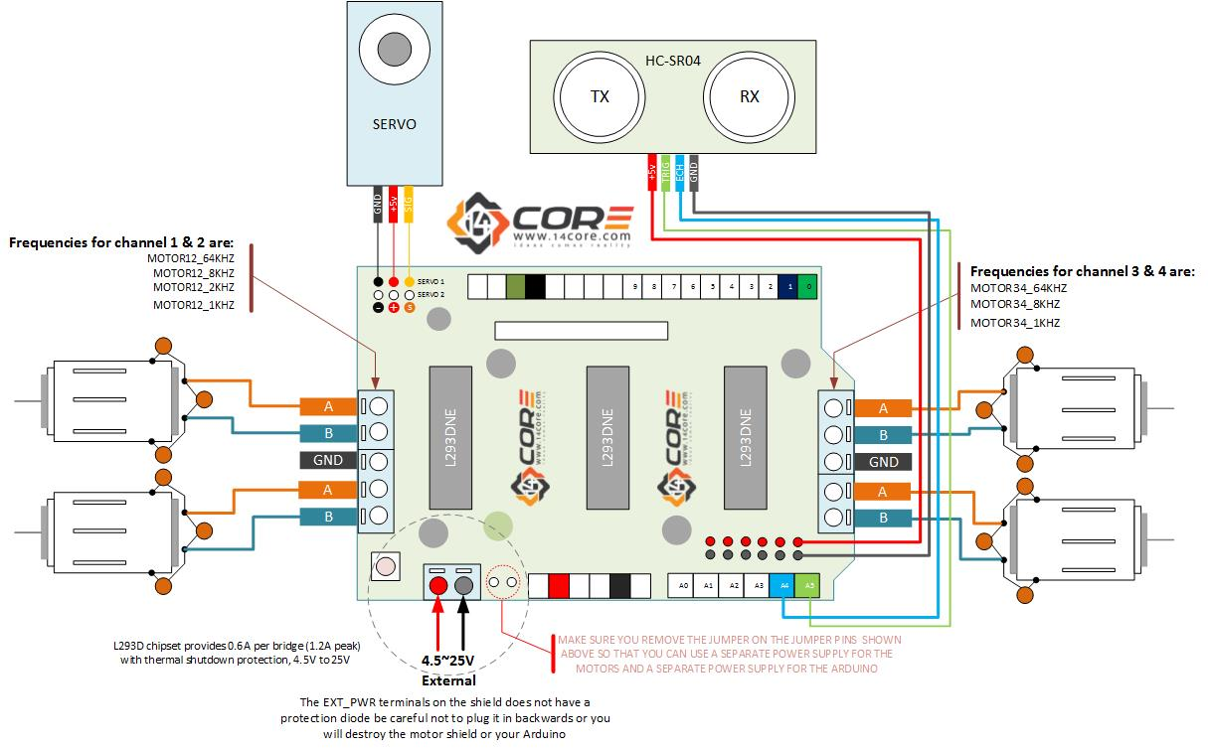
L289D Circuit Diagram

Slide 5
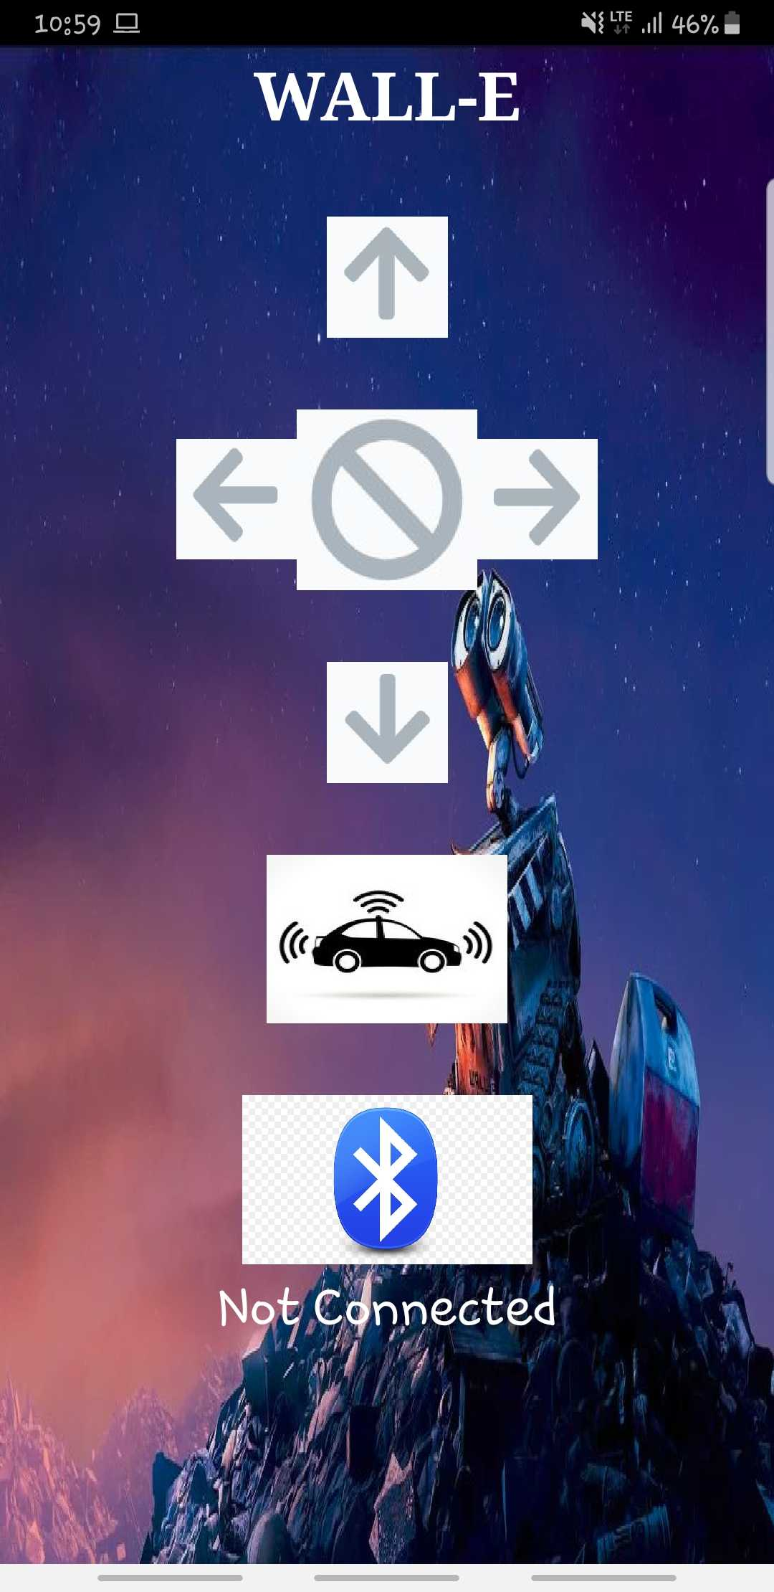
Mobile App

Slide 6
Demo

Slide 7
Thank you

